Slide 1
Digital Streaming Services
Team 3
KOH HONG YE (ACTORS)
Saw jun xian (movies)
Michael lee (reviews)
Au kok yong (customers)

Slide 2
Project Abstract
DSS is an automated system that allows customers to stream movies and view relevant information about the movies, actors and movie reviews.
Administrators are allowed to manage:
Movies
Actors
Reviews
Customers

Slide 3
Project Goals
Prove the application of concepts learnt and practice by applying to a project as a team.
Understand requirements, visualize them using UML diagrams, develop the requirements and verify them by testing.
Use distributed version control system for developing the project as a team.
Apply various libraries, frameworks and tools.
Create a simple working prototype, and follow an iterative fashion to make the prototype better and apply best practices.
Implement a loosely-coupled, highly reusable code and integrate all the modules developed from day 1 of the training.
Develop the project in parallel with the sessions.
Explore the docs and observe different patterns in code.
Integrate the code written by the members of the team.

Slide 4
Design & Understanding Requirements

Slide 5
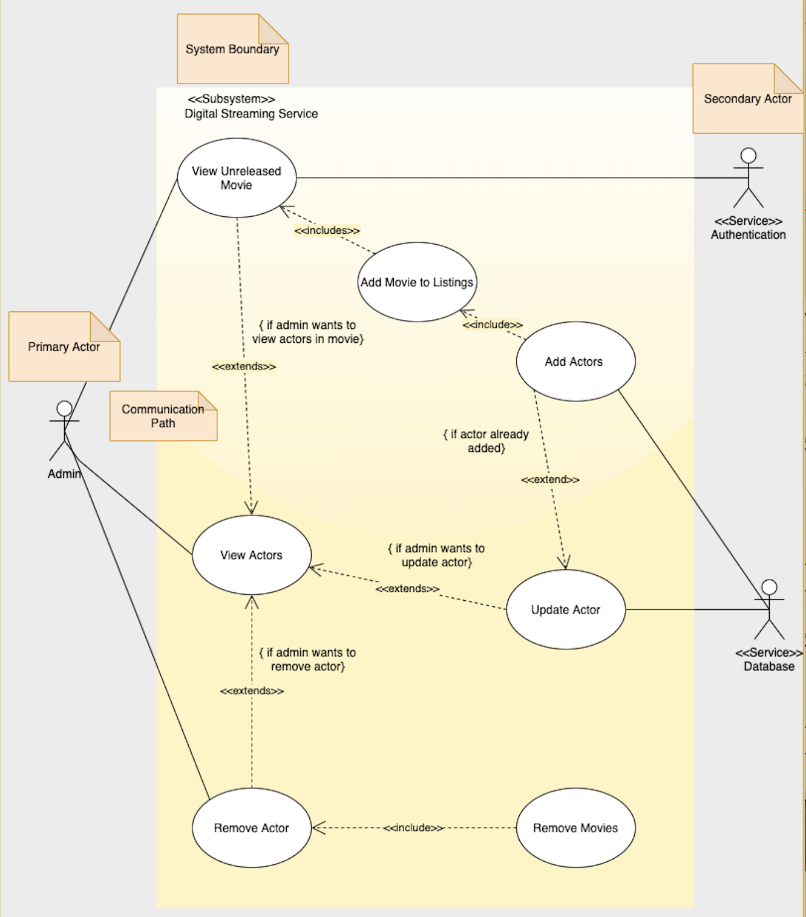

Use Case Diagram

Slide 6
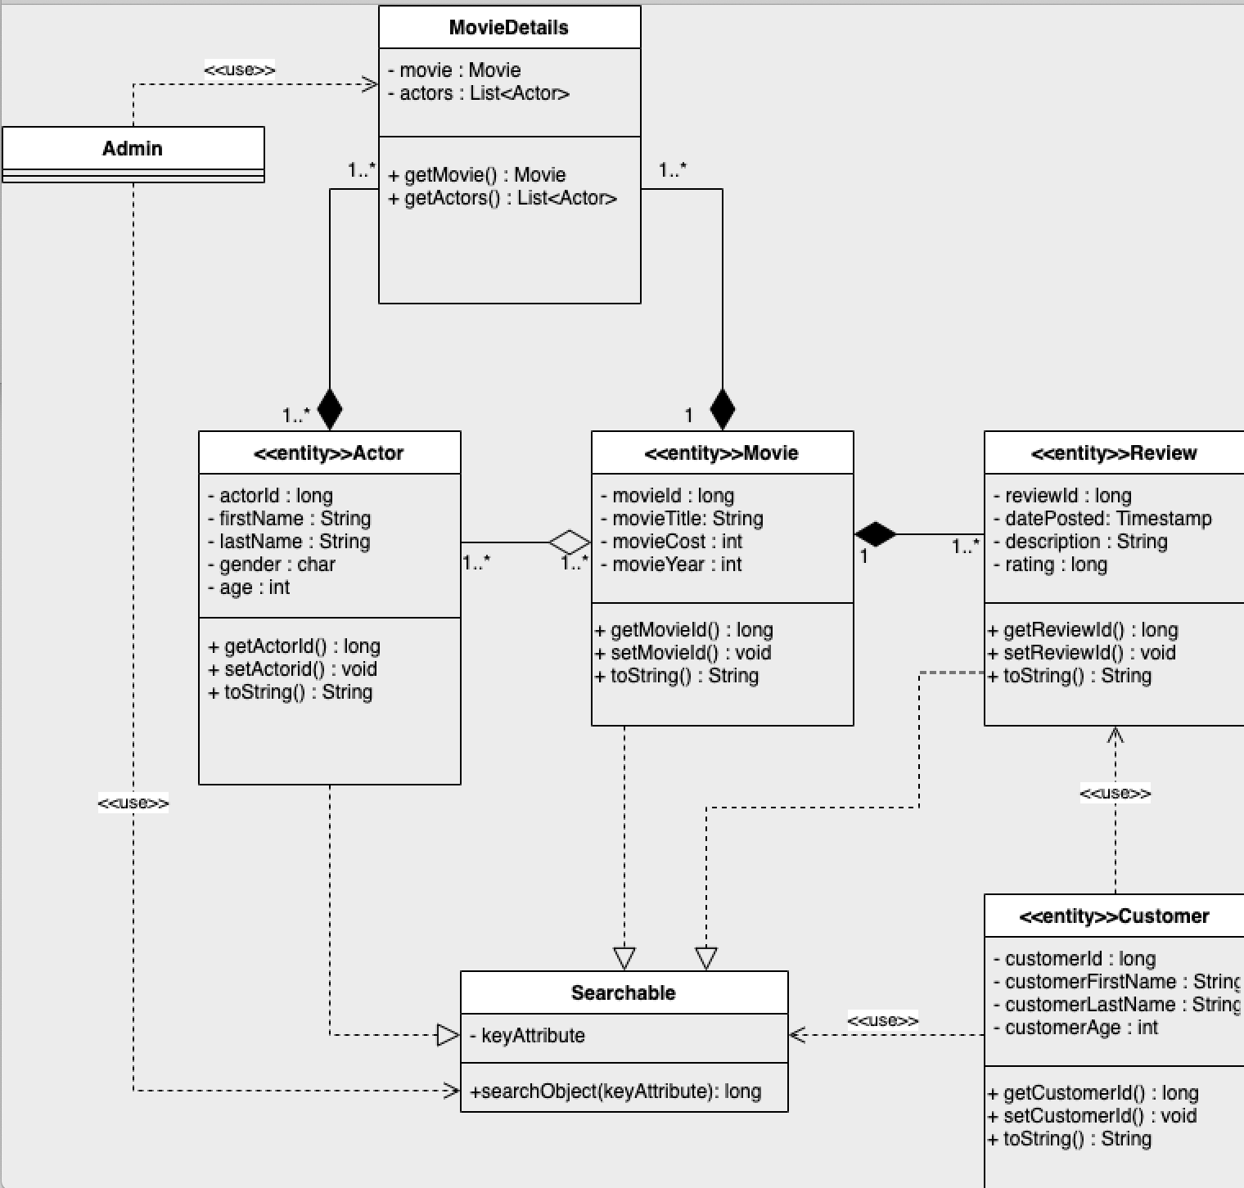
Class Diagram

Slide 7
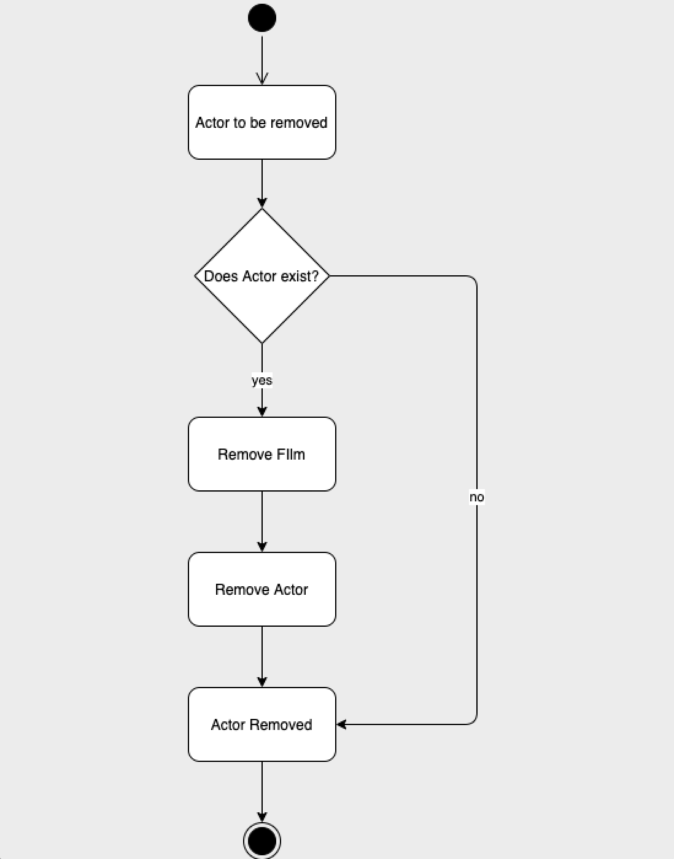
Activity Diagram

Slide 8
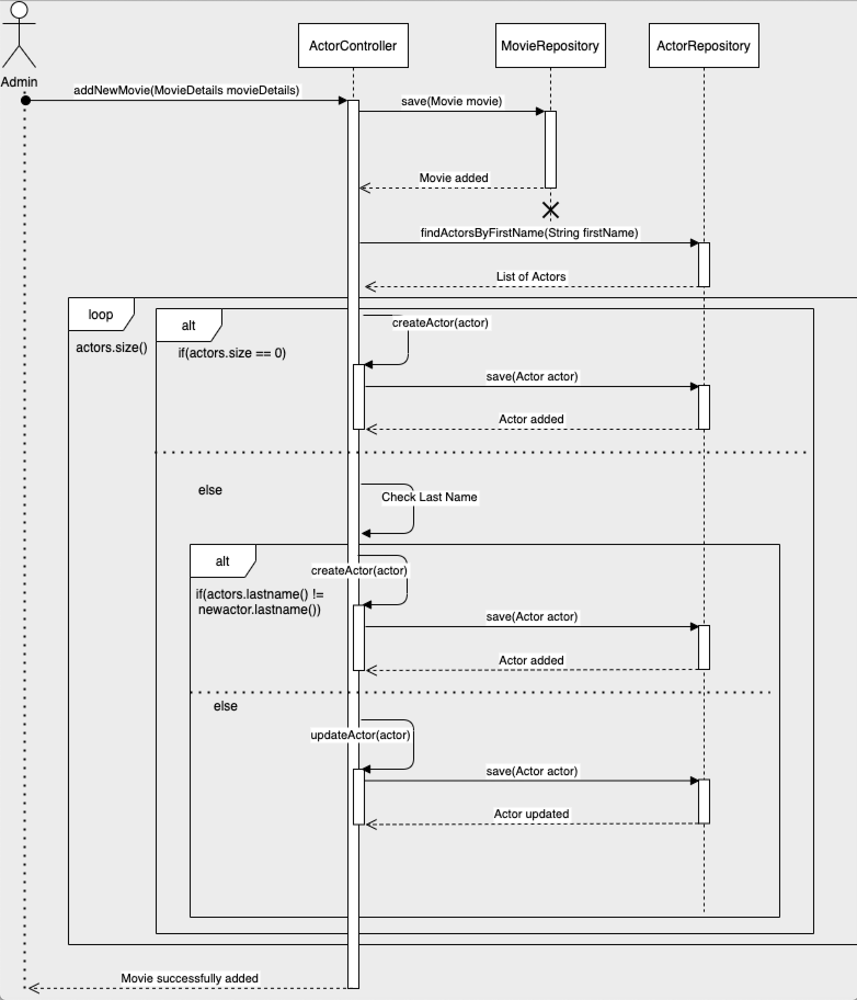
Sequence Diagram

Slide 9
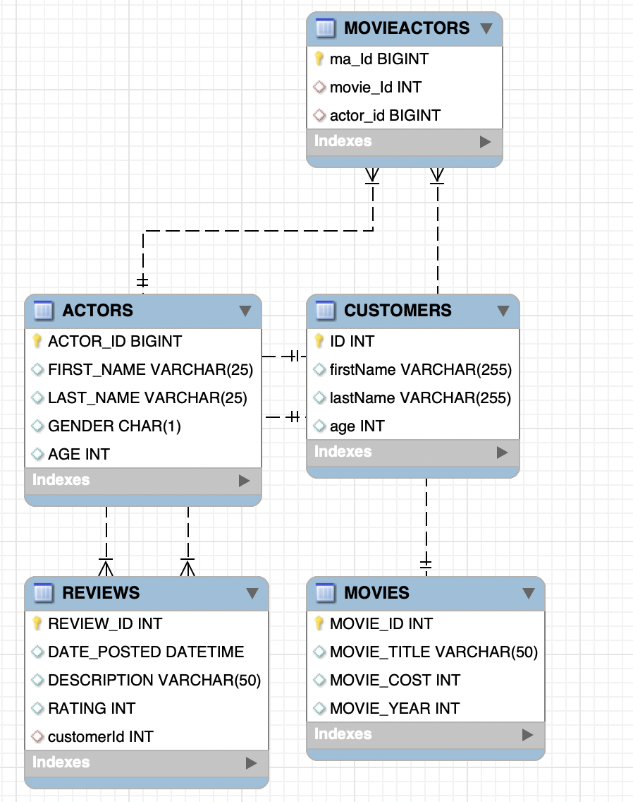
Entity Relationship Diagram

Slide 10
Layered Architecture

Slide 11
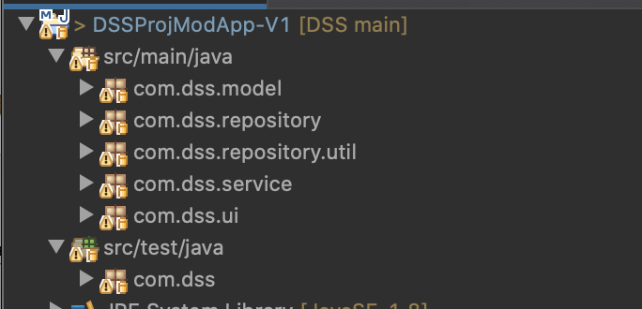
LAYERED ARCHITECTURE (Version 1)
Layers include:
Model
Repository
Service
User interface (UI)

Slide 12
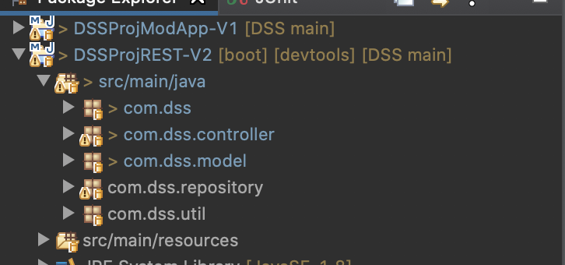
Layered architecture (version 2)
Layers includes:
Model
Repository
Controller
User interface (UI)

Slide 13
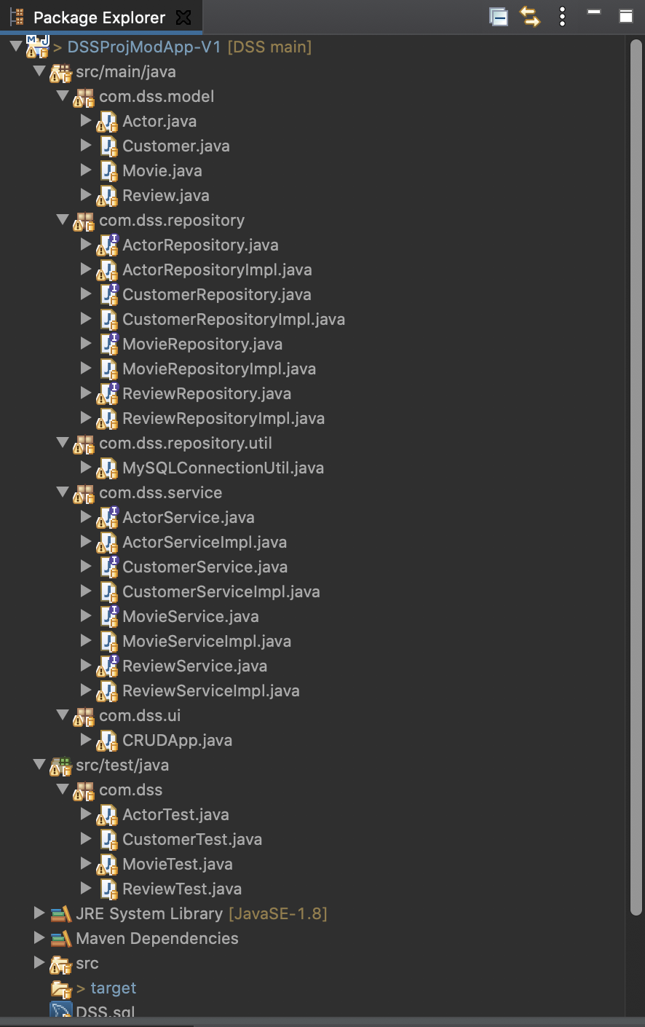
Overview layered architecture with modules
Actor
Customer
Movie
Review

Slide 14
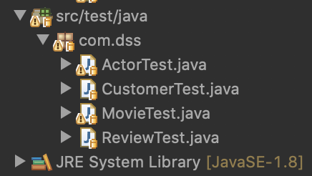
Testing
Testing with junit

Slide 15
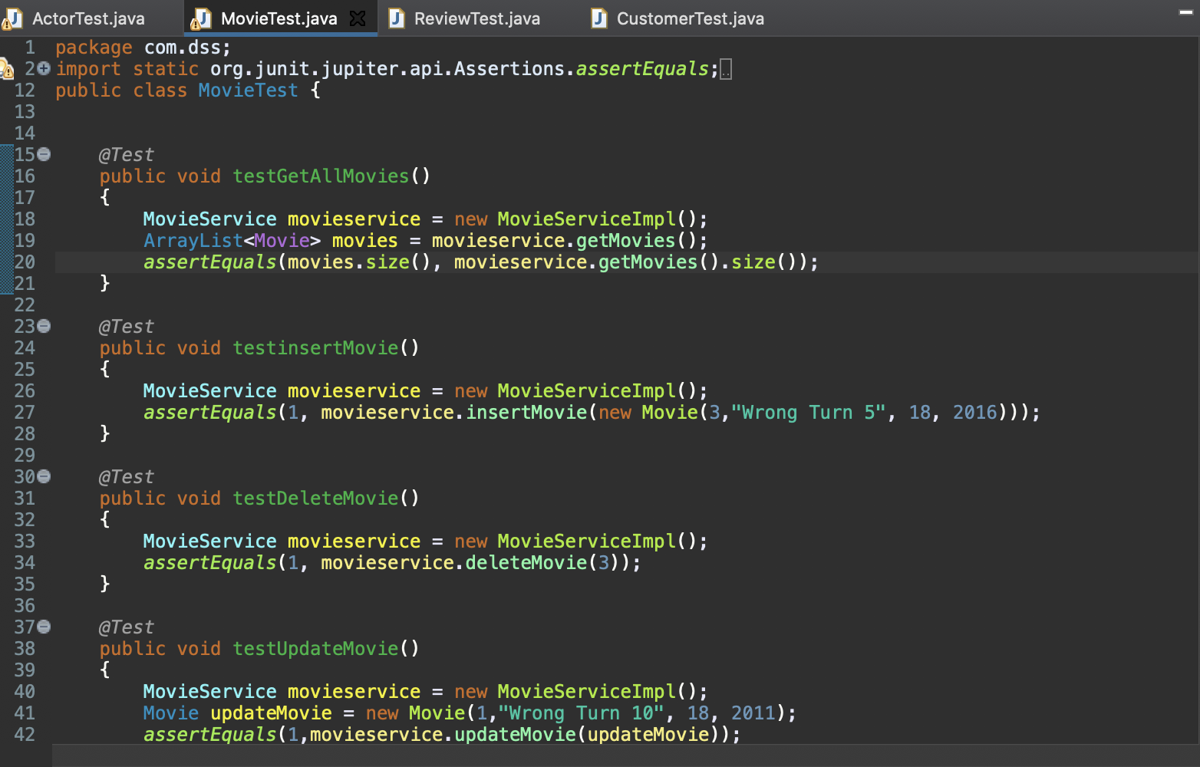

Slide 16
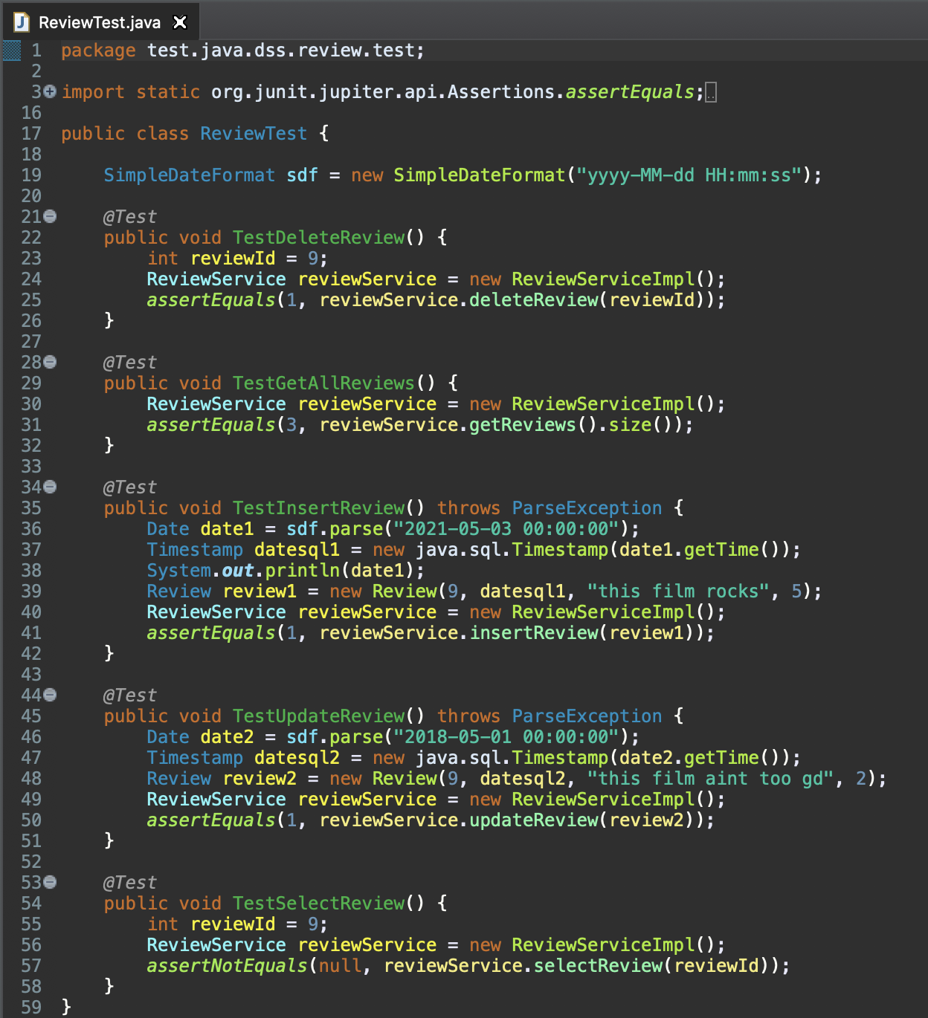
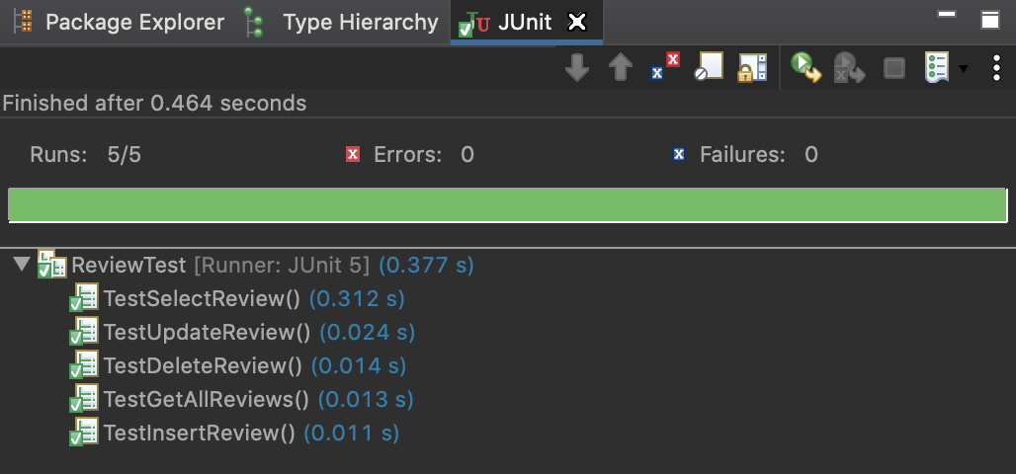

Slide 17
Frameworks (Spring Core)
XML Config
Annotation Config
Java config

Slide 18
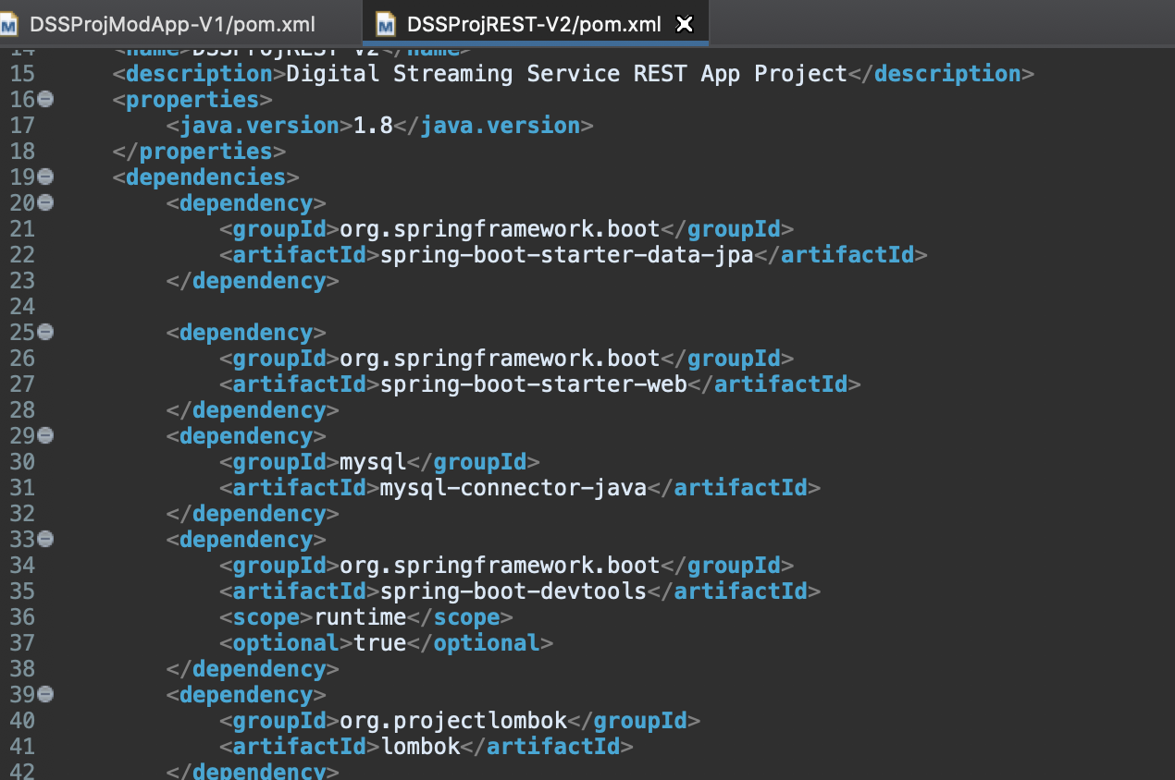


Dependencies
Lombok
Spring Data JPA
Spring Boot
MySQL driver

Slide 19
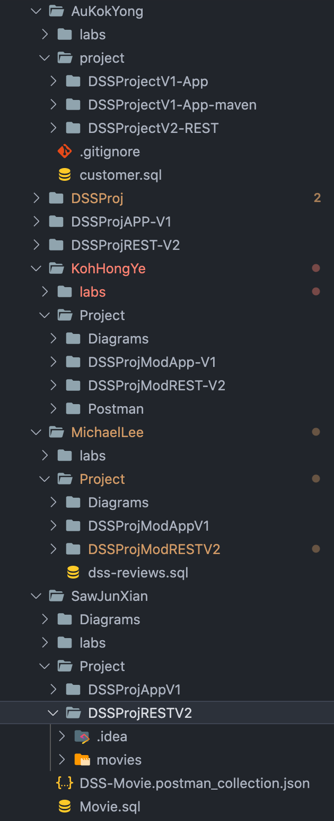
Modular Projects of Each Team Member
JDBC Project
Spring JDBC Project
REST Project

Slide 20
Git & GITHUB

Slide 21
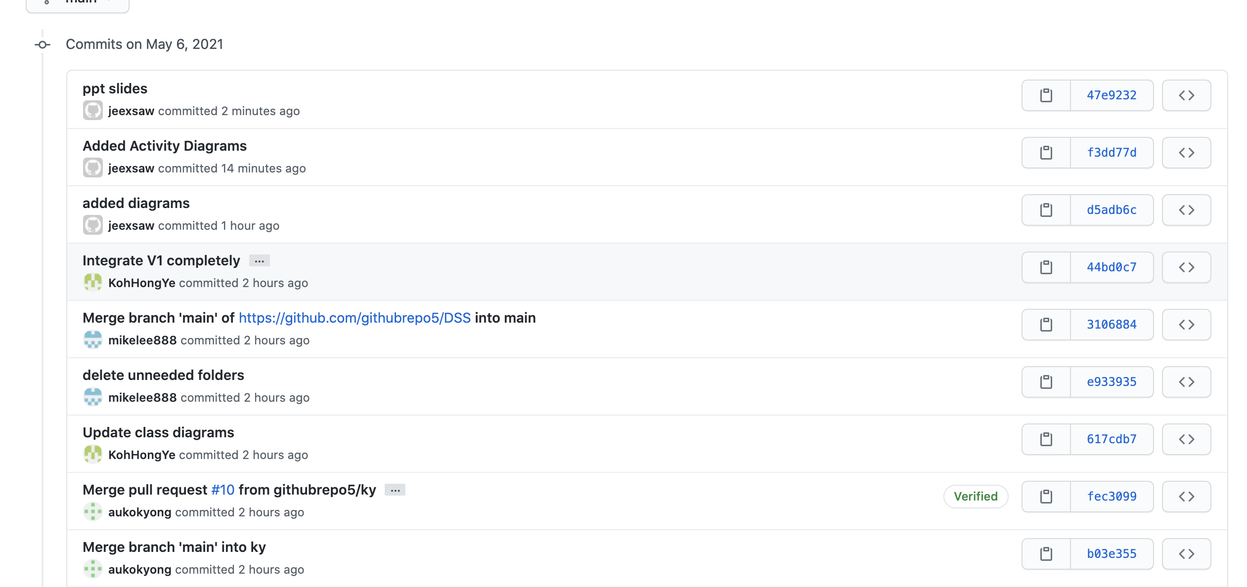
Screenshots

Slide 22
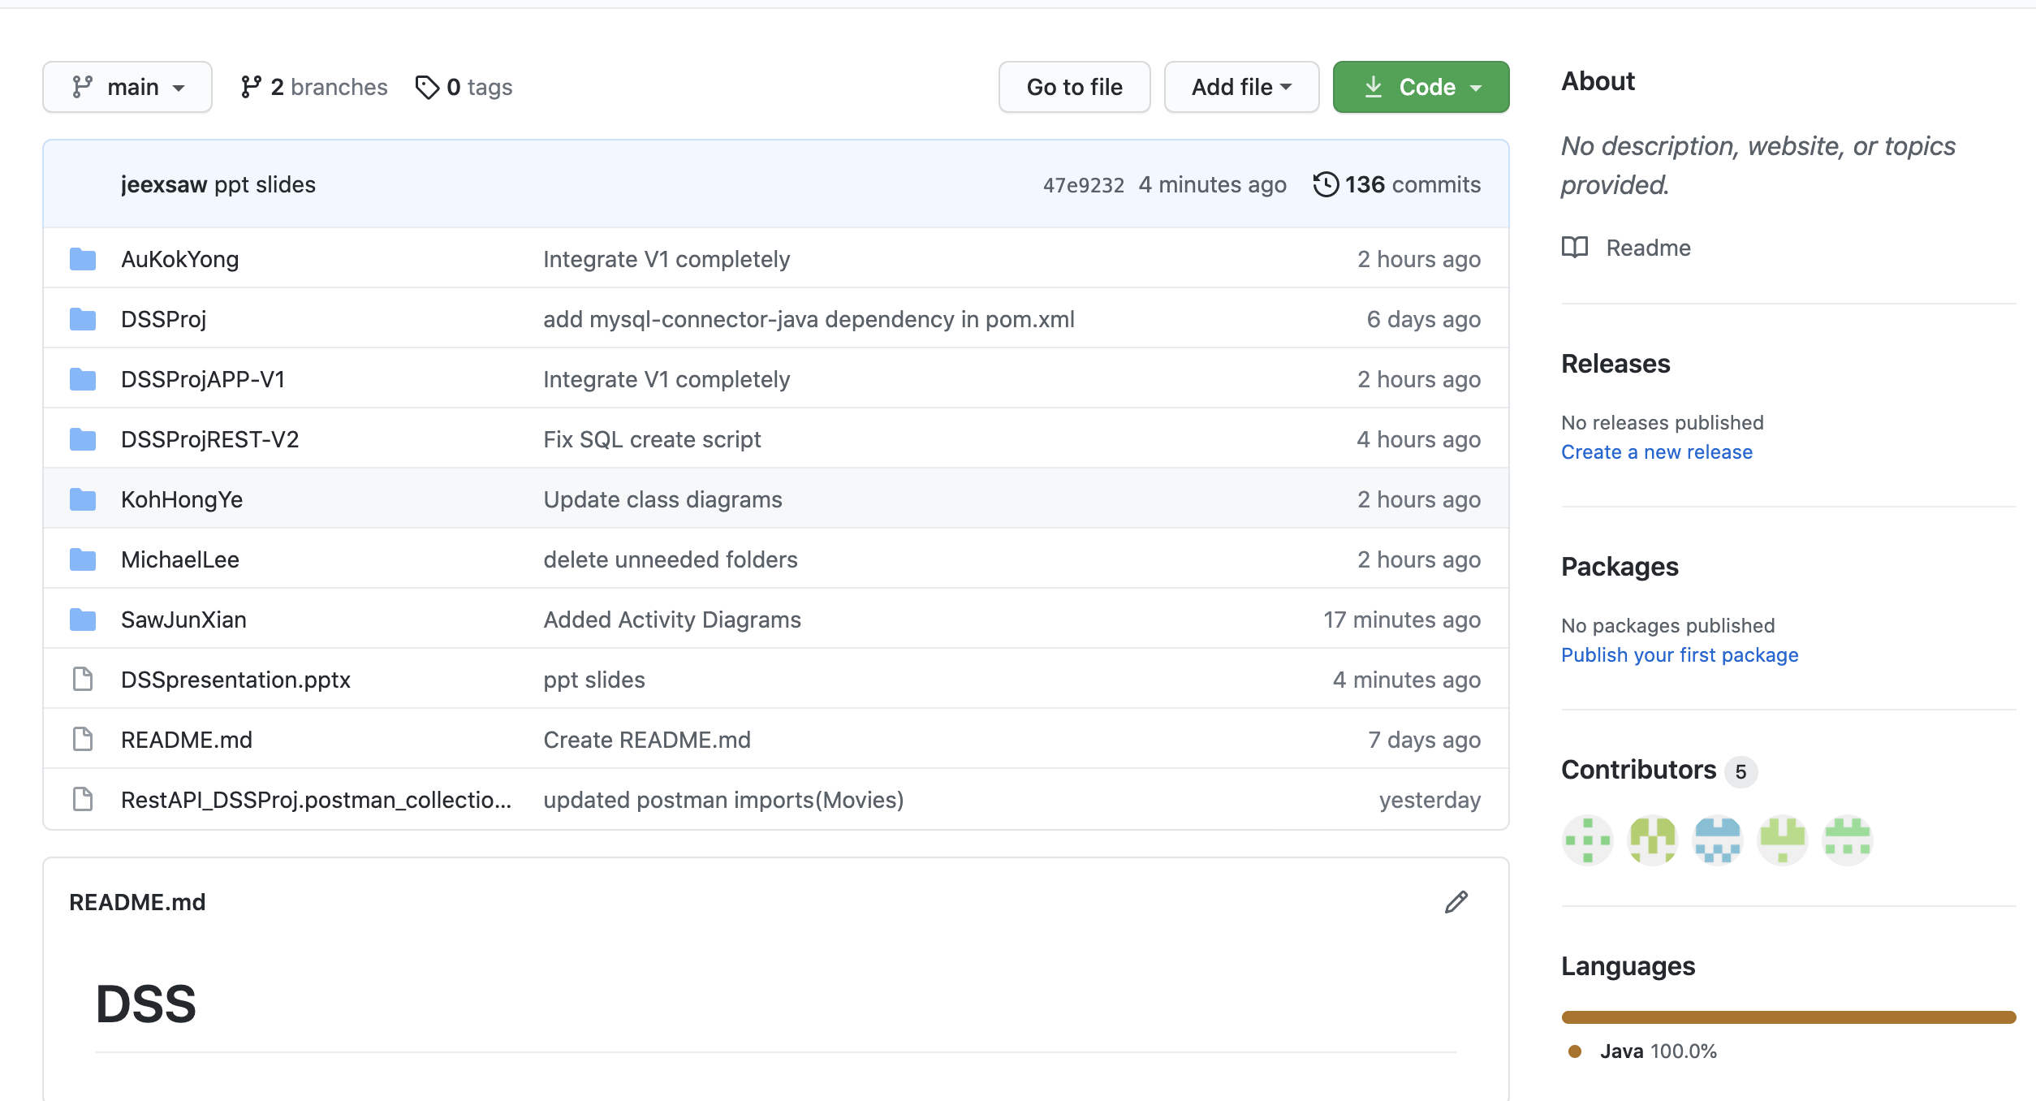
Screenshots

Slide 23
Learning & Experiences

Slide 24
Learning & Experiences
Learnt/reinforced the basics of the Java programming language
Worked on MySQL that reflected business needs
Complete UML diagrams that are beneficial
Find out how Maven helps in project management for Java projects
Writing Unit Tests based on business needs
Learnt Spring Framework for first time (for most of us) and find out the benefits by using it
Reemphasis on Code Quality over Completion Time
Time management
Communication and Collaboration between Team Members
Integrating everything learnt during the course into a project representing a business use case

Slide 25
Thank you!

